Slide 1
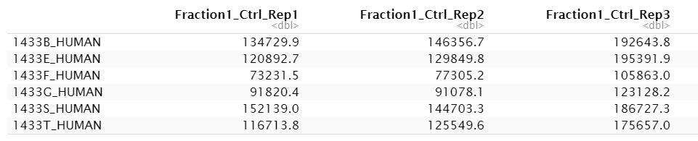
The data set
3 replicates with control sample
+ 3 replicates with RNase sample
separated into 25 fractions
→ 3*3*25 = 150 columns
rows = proteins (7086)
Amount of protein in fraction 1 of replicate 1 with control sample
EINHEIT???

Slide 2
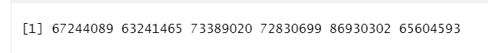
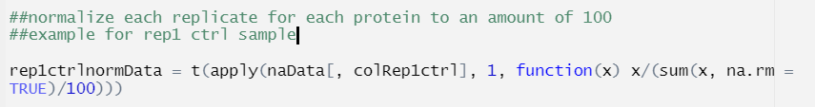

Statistical properties
every 6th measurement is part of one replicate
Different amounts of protein in replicates
many zeros

Slide 3
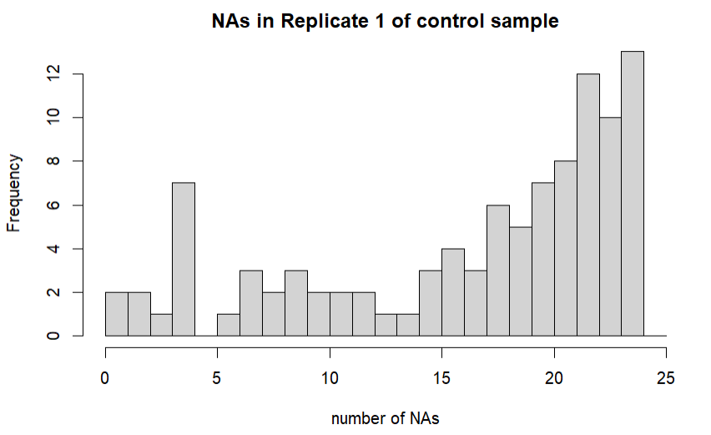
Statistical properties
Drop protein if more than 10 zeros at least two replicates in control and/or Rnase sample

Slide 4
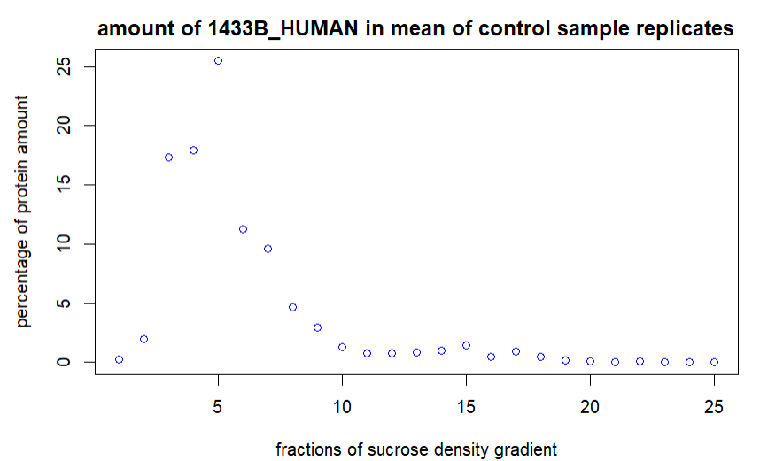
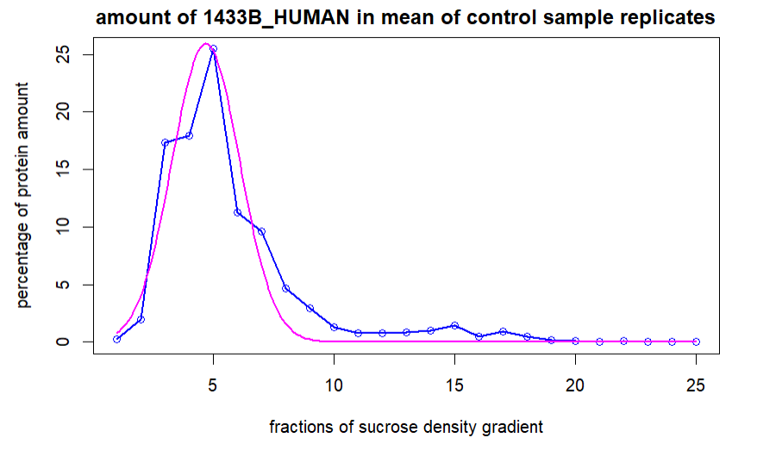
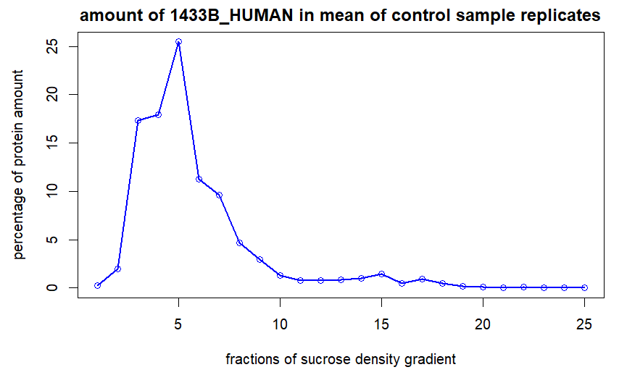
Normalization, Gaussian approximation

Slide 5
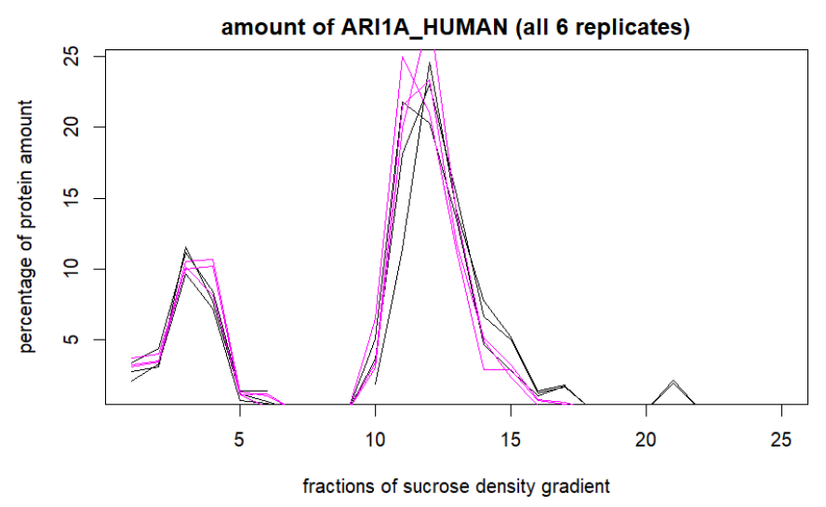
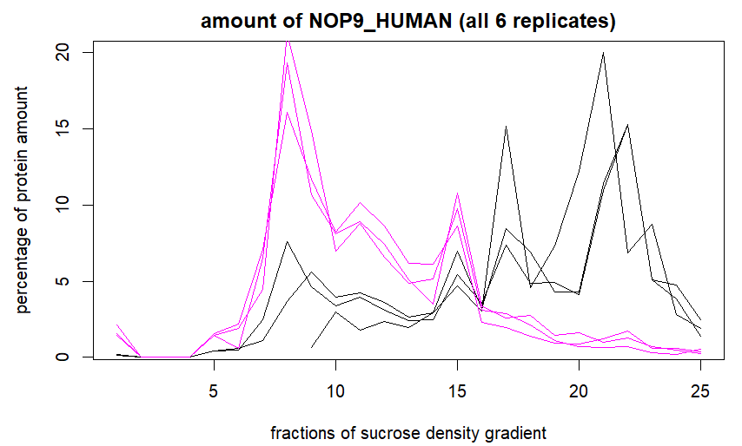
Shift between the fractions
Control = black
Rnase = magenta

